Slide 1
MITI Lab
Week 2 — Progress Report
Breast Lesion Classification on CBIS-DDSM
01
Visual introduction — what do the 3 lesion classes look like?
02
Data preparation & updated 3-class folder structure
03
CC + MLO dual-view — evidence for using both views
04
PyRadiomics — prior work, feature plan & visualizations

Slide 2
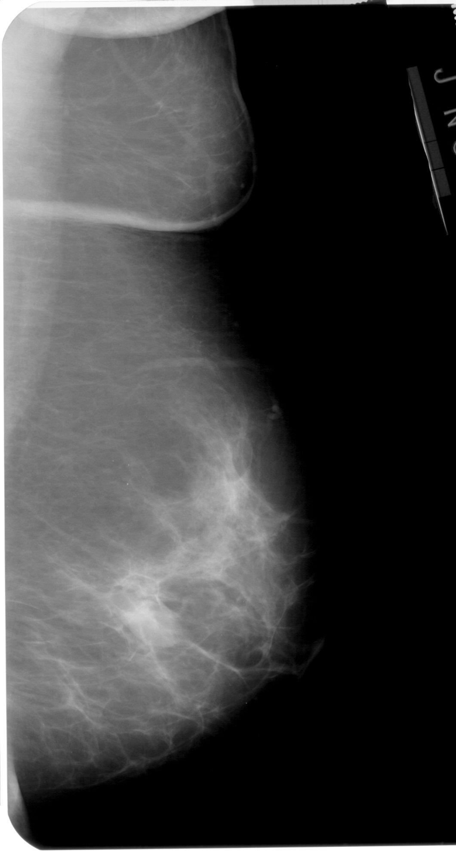
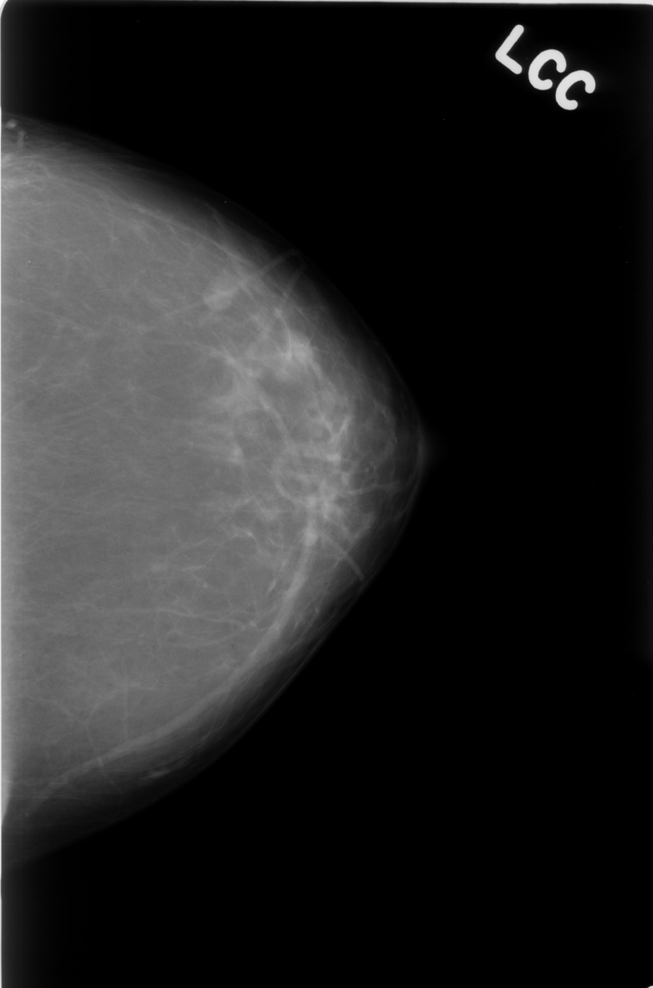
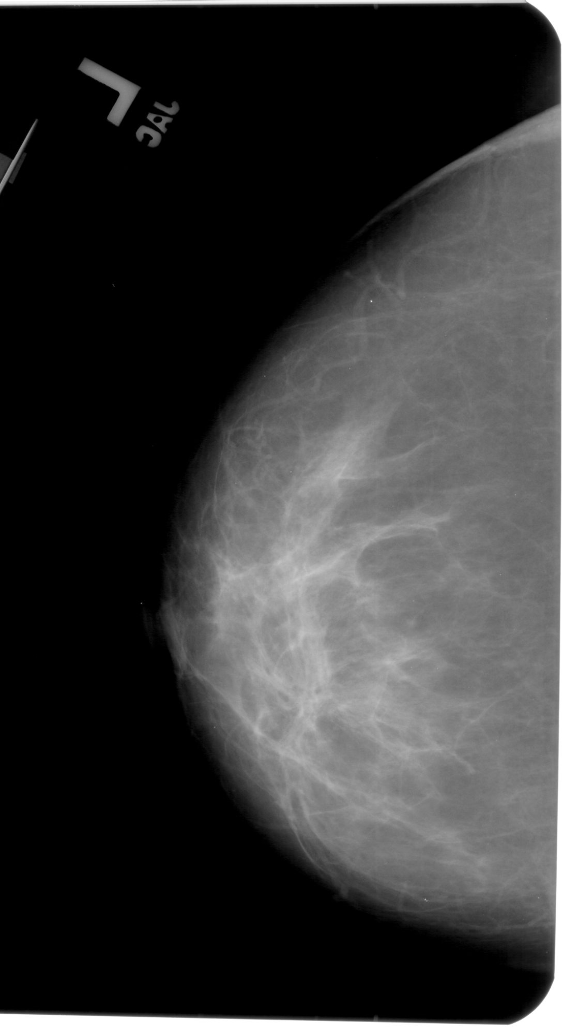
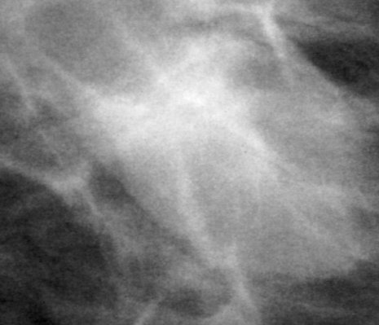
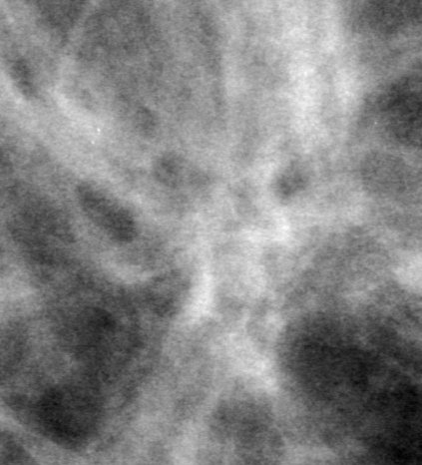
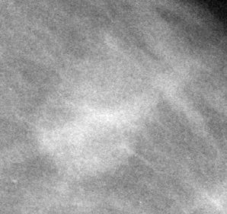
01
Introduction — What Do the Three Lesion Classes Look Like?
Malignant
Benign
Normal / Healthy
FULL MAMMOGRAM
FULL MAMMOGRAM
FULL MAMMOGRAM
ROI / CROPPED
ROI / CROPPED
ROI / CROPPED
Irregular shape, spiculated edges, heterogeneous texture. High BI-RADS (4–5).
Rounder shape, well-defined margins, uniform texture. Lower BI-RADS (2–3).
No visible mass. BENIGN_WITHOUT_CALLBACK — confirmed normal by biopsy.

Slide 3
02
Data Preparation — Folder Structure (Updated for 3-Class)
BEFORE — 2 Class
AFTER — 3 Class (Current Plan)
Mass_Train/
├── b/ (benign)
│ └── cropped images
├── m/ (malignant)
│ └── cropped images
Mass_Test/
├── b/ (benign)
│ └── cropped images
├── m/ (malignant)
│ └── cropped images
Train/
├── n/ (normal) ← NEW
│ └── cropped images
├── b/ (benign)
│ └── cropped images
├── m/ (malignant)
│ └── cropped images
Test/
├── n/ (normal) ← NEW
│ └── cropped images
├── b/ (benign)
│ └── cropped images
├── m/ (malignant)
│ └── cropped images
Normal class = BENIGN_WITHOUT_CALLBACK cases from CBIS-DDSM. Crops will be generated and balanced against benign & malignant counts before CNN training.

Slide 4
03
CC + MLO Dual-View — Should We Use Both Views?
Network
CC only
MLO only
CC + MLO
AUC (dual)
VGG16
85.58%
88.57%
90.84%
94.78%
ResNet50
85.17%
90.34%
90.49%
91.98%
ResNet101
86.80%
90.97%
91.98%
92.82%
InceptionV3
82.38%
89.80%
90.00%
93.61%
CC View
MLO View
▲
MLO alone beats CC alone — captures more breast tissue at 45° angle
★
Dual-view always outperforms single-view — +2–5% accuracy, up to +21% AUC (ResNet101)
✓
Clinical standard: radiologists always read both CC & MLO — AI should do the same
Source: Yan et al. 'Towards improved breast mass detection using dual-view mammogram matching', Medical Image Analysis, 2021

Slide 5
04
PyRadiomics — What It Is & Prior Work
What is PyRadiomics?
Python library that extracts handcrafted mathematical features from medical images — given an image and an ROI mask.
Shape
]
First-order
Mean, entropy, skewness — pixel intensity statistics inside the ROI
GLCM texture
Contrast, homogeneity, correlation — how neighboring pixels relate

Slide 6
04
PyRadiomics — Feature Extraction Plan for 3 Classes
image.dcm
PyRadiomics
extractor
Shape
First-order
GLCM
Feature
table
CNN
input
(added)
Normal
Benign
Malignant
Low entropy — uniform background tissue
Higher sphericity — rounder shape
Low sphericity — irregular shape
High homogeneity — no lesion present
Circumscribed margins — low GLCM contrast
High GLCM contrast — heterogeneous texture
Sphericity N/A — no mass boundary
Moderate entropy
High entropy — chaotic intensity
Small surface area / volume
Well-defined boundary in mask
Spiculated edges — high surface area
Goal: prove which features statistically differ across 3 classes → select most discriminative features for CNN fusion

